Slide 1
Node.js Course – 1st Session
Node.js Overview
Lance Zhou
2016.08.28

Slide 2
Agenda
1
MEAN and Node.js Basic Introduction
2
Node.js Setup and NPM Usage
3
Hello Node.js Demo
4
Node.js Module
5
Node.js Async Programming Style
6
Node.js Popular Packages Brief
7
Node.js Debug in VS Code
8
Exercise

Slide 3
1
MEAN and Node.js Basic Instruction

Slide 4
1
What is a MEAN stack
MEAN is a full-stack JavaScript framework
MEAN stands for:
MongoDB as the database
Express as the web framework
AngularJS as the frontend framework, and
Node.js as the server platform

Slide 5
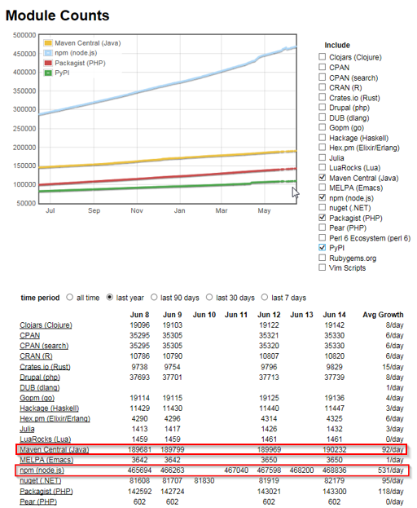
2
The advantages of MEAN stack
Support for the MVC pattern
JSON is used for transferring data
Node.js huge module library(475k+)
Open source
Single language is used in the whole application

Slide 6
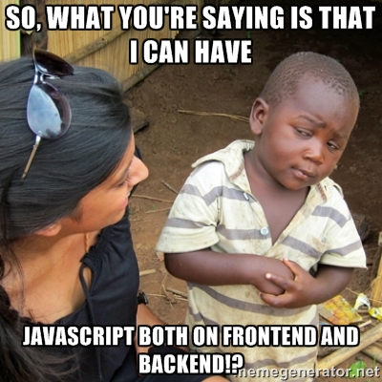

Slide 7
3
What is the Node.js
is a open-source, cross-platform runtime environment built on top of Chrome’s V8 JavaScript engine
is for developing server-side web application
operates on single thread but can create highly scalable servers
is using in these companies
IBM, Microsoft, Yahoo!, Walmart, Groupon, SAP, LinkedIn, PayPal…
Notes:
can be distributed in Mac OS X, Unix, Window, IOS and Android
V8 compiles JavaScript source code to native machine code instead of interpreting it in real time
JavaScript is a single threaded programming language, single threaded Runtime, it has a single call stack. And it can do one thing at a time, that's what a single thread means, the program can run one piece of code at a time.
using non-blocking I/O calls, allowing it to support tens of thousands of concurrent connections without incurring the cost of thread context switching, instead of processes or threads
A downside of this single-threaded approach is that Node.js doesn't allow scaling with the number of CPU cores of the machine it is running on without using an additional module such as cluster, StrongLoop Process Manager, or pm2. However, developers can increase the default number of threads in the libuv threadpool, those threads likely to be delegated to multiple cores by the server operating system.
https://github.com/nodejs/node-v0.x-archive/wiki/Projects,-Applications,-and-Companies-Using-Node
https://www.paypal-engineering.com/2013/11/22/node-js-at-paypal/

Slide 8
4
The Pros and Cons of Node.js
Good at
Data Intensive and Real Time Applications
JSON APIs
Data-streaming Applications
Not Good at
Heavy computation scenario
Application with Relational DB behind

Slide 9
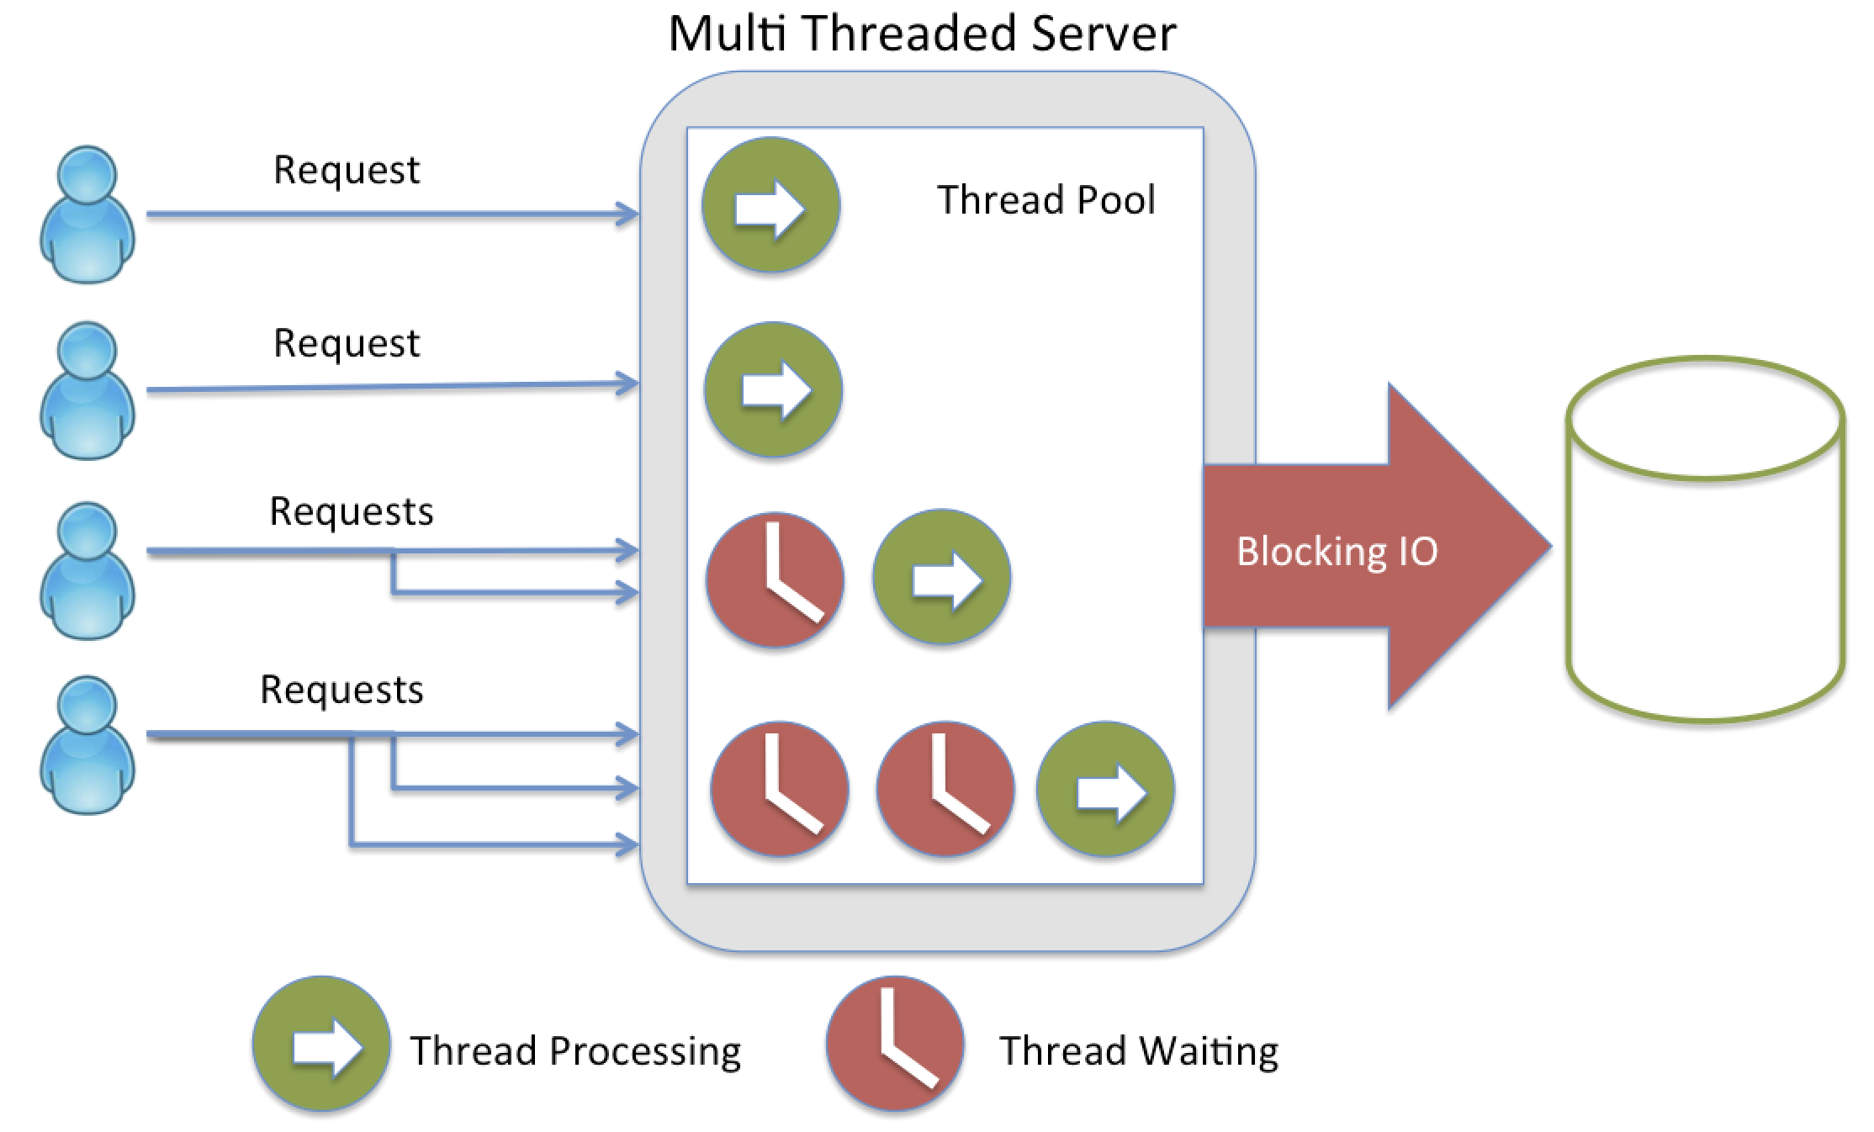
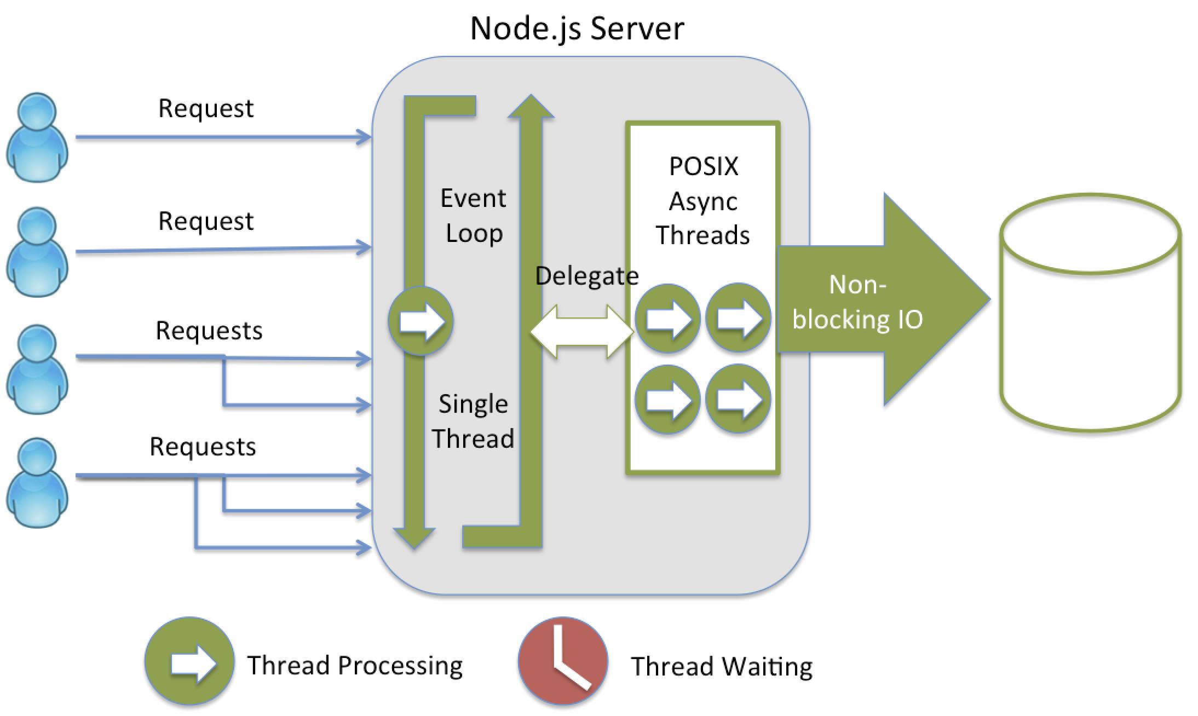
5
Node.js server VS traditional server
Blocking IO VS Non-Blocking IO
Notes:
https://strongloop.com/strongblog/node-js-is-faster-than-java/
A quick calculation: assuming that each thread potentially has an accompanying 2 MB of memory with it, running on a system with 8 GB of RAM puts us at a theoretical maximum of 4000 concurrent connections, plus the cost of context-switching between threads. That’s the scenario you typically deal with in traditional web-serving techniques. By avoiding all that, Node.js achieves scalability levels of over 1M concurrent connections (as a proof-of-concept).

Slide 10
2
Node.js Setup and NPM Usage

Slide 11
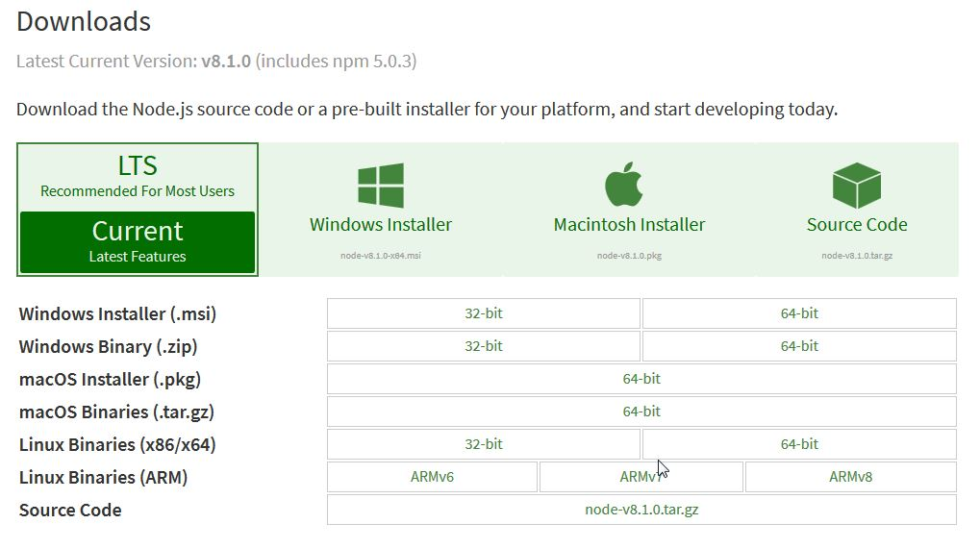
1
Install Node.js
Install related OS version of Node.js from http://nodejs.org/

Slide 12


2
Verify and Run Node.js
After installation, add Node.js installation path to Windows Environment Variable Path
Open your CMD in Windows, check installation is ok
Start JavaScript in REPL by node command
Notes:
Show in windows CMD

Slide 13
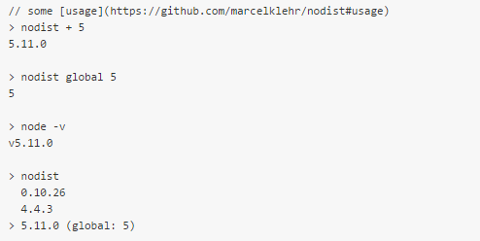
3
Node.js Version Management
nodist, Natural node.js and npm version manager for windows
install it
Notes:
Show in windows CMD

Slide 14

4
NPM usage
npm is short for Node.js Package Management
npm helps developer share and reuse code
npm is installed with Node.js
npm version management
Notes:
Show in windows CMD

Slide 15
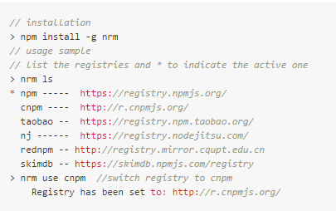
5
npm registry and management
npm registry is the JavaScript Package Registry
nrm, NPM registry manager
Notes:
Show in windows CMD

Slide 16
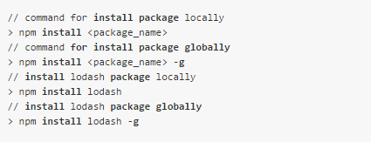
6
npm install [-g|--save]
Install package in two modes
local mode installs the package inside the Node.js application’s node_modules folder
global mode installs the package in system available to any other Node.js application
Notes:
Show in windows CMD

Slide 17
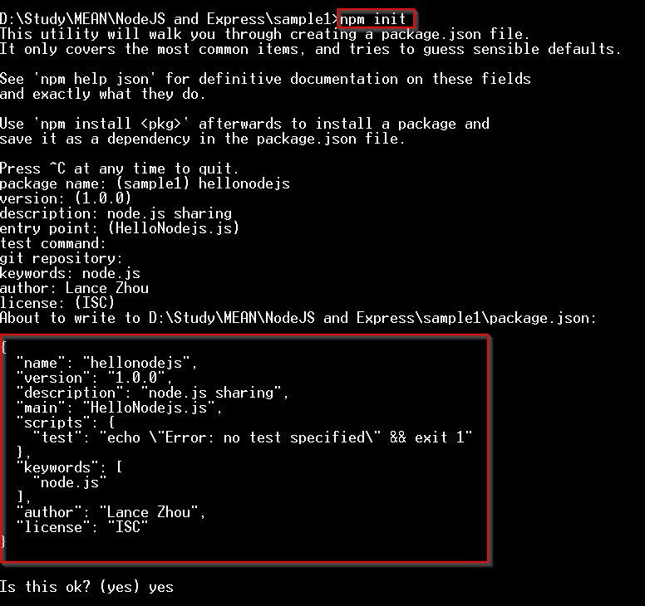
7
npm init
build a package.json file
Notes:
Show in windows CMD

Slide 18
3
Hello Node.js Demo

Slide 19
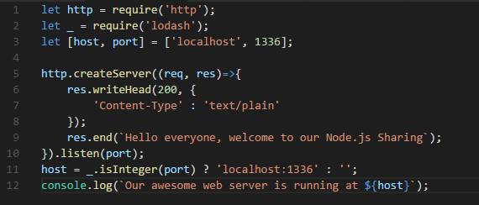
1
Build a simple http server
npm init to build a package.json
build HelloNodejs.js file
npm install lodash package

Slide 20
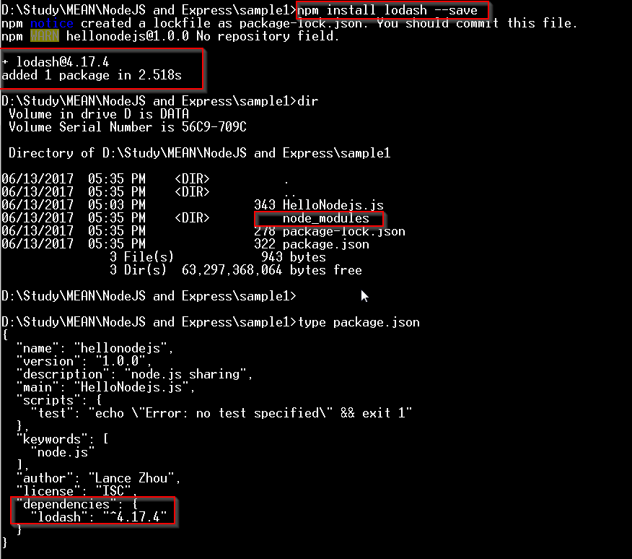
2
npm install related package
npm install lodash and register in the package.json file

Slide 21
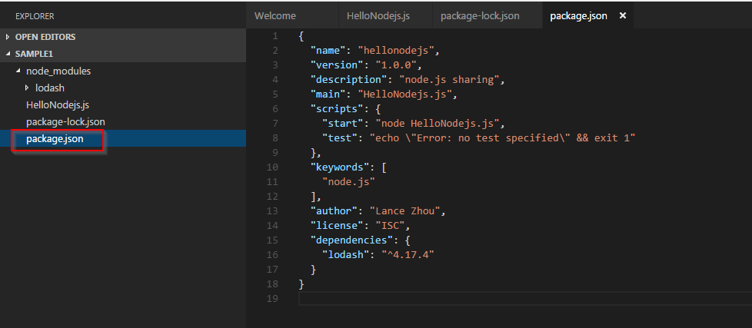
3
package.json
includes the meta data of the project and the dependency of other modules

Slide 22
4
Node.js Module

Slide 23
1
Node.js Module
Main Module：scheduling other modules
Binary Module：C/C++; .node & .js
Package：multiple sub modules
Core Modules：events, fs, http
File Modules：express, socket.io

Slide 24
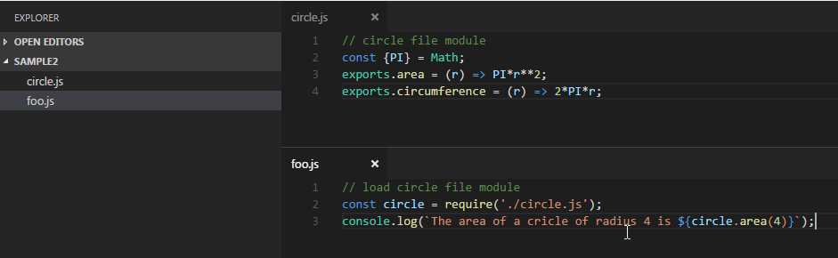
1
Node.js Module
Native Module
http, fs
File Module, including .js , .node and .json files
each file is treated as a separate module
.js files are interpreted as JavaScript text files
.json files are parsed as JSON text files
.node files are interpreted as compiled addon modules loaded with dlopen

Slide 25
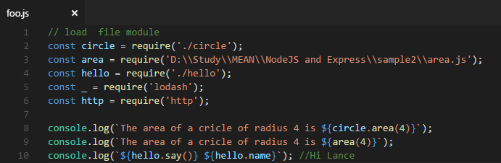
2
Node.js require
used to load the module into your code
require() can accept
http, fs etc. as native module
./circle as file module by relative path
D:\\abc\\def as file module by absolute path
lodash as none native module

Slide 26
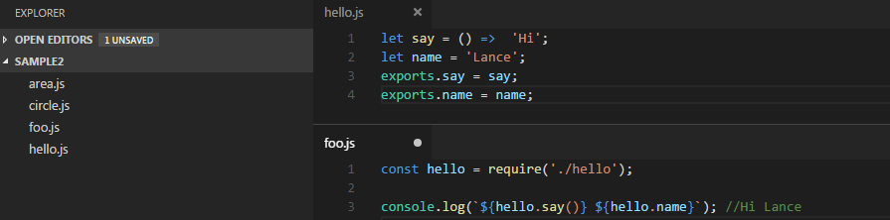
3
Node.js exports
exports is object contained in each module
allows you to expose pieces of your code when the module is loaded
can expose public properties and methods

Slide 27
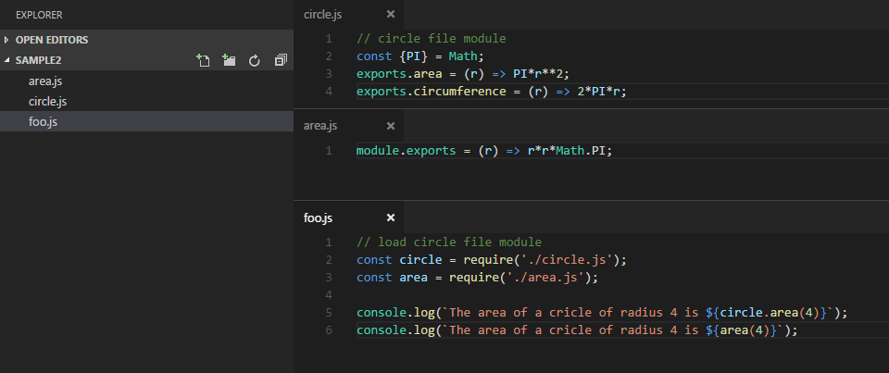
4
Node.js exports & module.exports
exports = module.exports = {};
exports = function(r){…}?

Slide 28
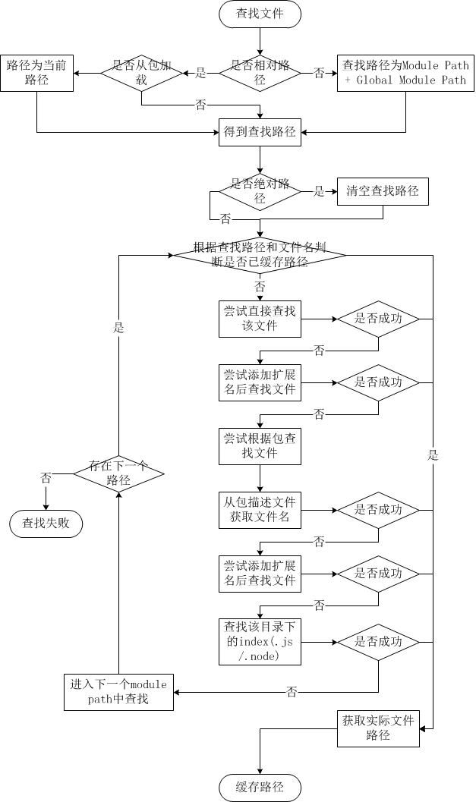
4
Node Module—Find File Strategy

Slide 29
5
Node Module—Load Module Strategy
Start require
In File Module Cache
N
In Native Module Cache
Y
Native Module
N
N
Search File Module
Load Native Module
Y
Y
Load File Module By Extension
Cache Native Module
Cache File Module
Return exports

Slide 30
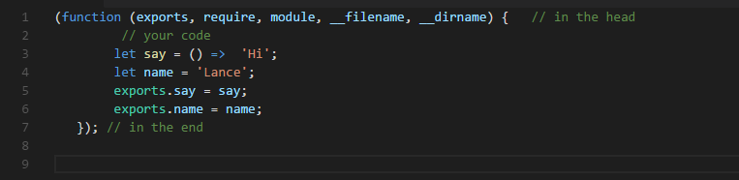
6
Node Module Wrapper
Before a module's code is executed, Node.js will wrap it with a function wrapper that looks like the following
Variable scope isolation among module files

Slide 31
5
Node.js Async Programming Style

Slide 32
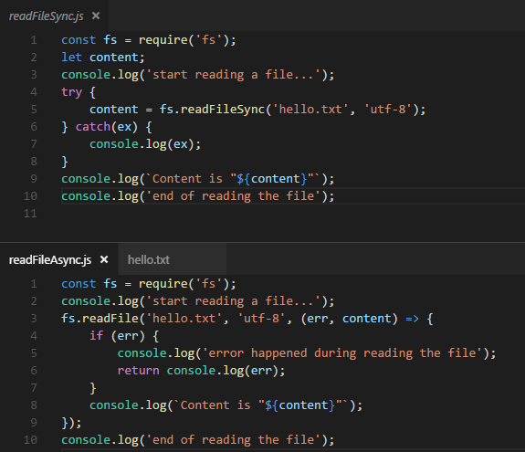
1
Asynchronous programming in Node.js
Asynchronous I/O is a form of input/output processing that permits other processing to continue before the transmission has finished.
Notes:
http://justinklemm.com/node-js-async-tutorial/

Slide 33
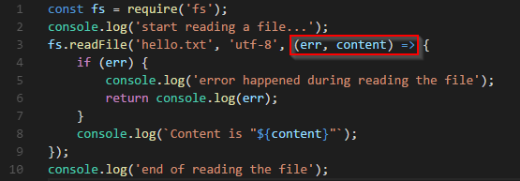
2
Callback in Asynchronous programming
A callback is a function that is passed as an argument to another function and is executed after its parent function has completed
fs.readFile(“hello.txt”, callback_function);
when the “hello.txt” file is finished reading, Node.js event loop will call the “callback_function” to process the pre-defined logic, and it will embedded 2 parameters (err, content) to this function.

Slide 34
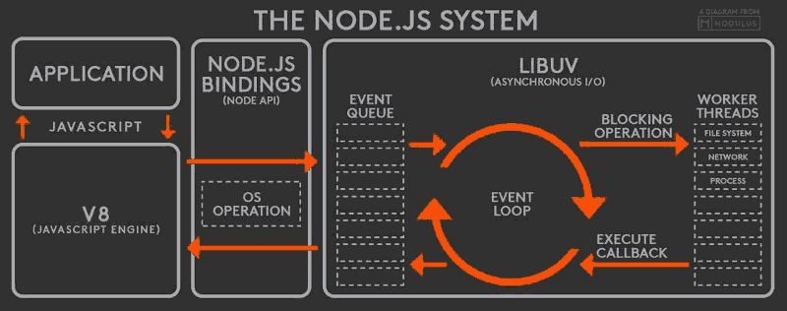
3
Event Loop
The event loop is in the heart of Node.js
Event-driven programming is a programming paradigm in which the flow of the program is determined by events such as user actions (mouse clicks, key presses), sensor outputs, or messages from other programs/threads.
Notes:
http://latentflip.com/loupe
What happened? Even though V8 is single-threaded, the underlying C++ API of Node isn't. It means that whenever we call something that is a non-blocking operation, Node will call some code that will run concurrently with our javascript code under the hood. Once this hiding thread receives the value it awaits for or throws an error, the provided callback will be called with the necessary parameters.
The ‘some code’ we mentioned is actually part of libuv. libuv is the open source library that handles the thread-pool, doing signaling and all other magic that is needed to make the asynchronous tasks work. It was originally developed for Node.js but a lot of other projects use of it by now.

Slide 35
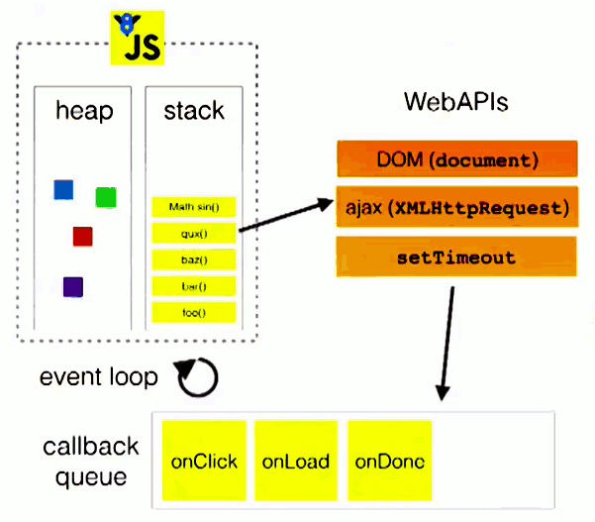
4
Callback and Event Loop
http://latentflip.com/loupe
Notes:
how JavaScript's call stack/event loop/callback queue interact with each other.

Slide 36
6
Node.js Popular Packages Brief

Slide 37
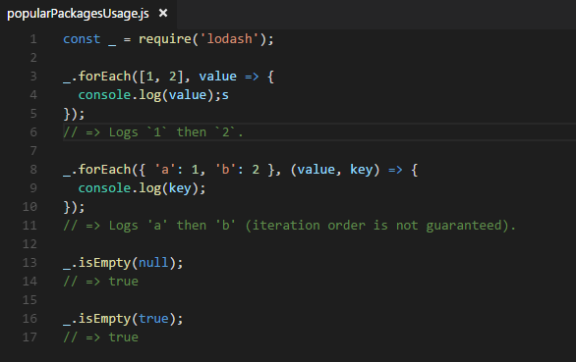
1
lodash
A modern JavaScript utility library delivering modularity, performance & extras.
$ npm install lodash --save
Notes:
http://justinklemm.com/node-js-async-tutorial/

Slide 38
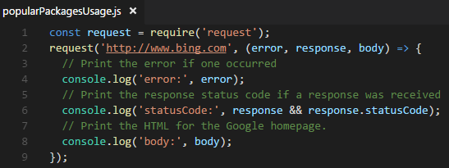
2
request
Request is designed to be the simplest way possible to make http calls. It supports HTTPS and follows redirects by default.
$ npm install request --save
Notes:
http://justinklemm.com/node-js-async-tutorial/

Slide 39
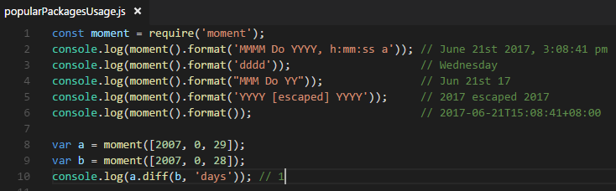
3
moment
Parse, validate, manipulate, and display dates in JavaScript.
$ npm install moment --save
Notes:
http://justinklemm.com/node-js-async-tutorial/

Slide 40
7
Node.js debug
Notes:
http://i5ting.github.io/node-debug-tutorial/#701

Slide 41
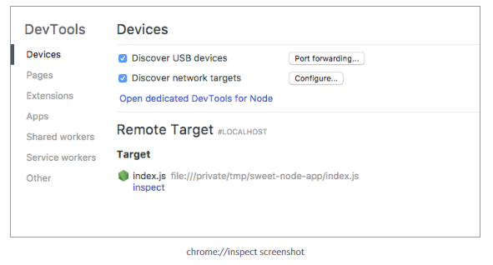
1
Debugging Node.js with Chrome DevTools
Run node with the –inspect flag
You can also break on the first statement of the script with --debug-brk
Open about:inspect in Chrome
$ node –inspect index.js
$ node –inspect –debug-brk index.js
Notes:
Since version 6.3, Node.js provides a buit-in DevTools-based debugger which mostly deprecates Node Inspector, see e.g. this blog post to get started. The built-in debugger is developed directly by the V8/Chromium team and provides certain advanced features (e.g. long/async stack traces) that are too difficult to implement in Node Inspector.
https://medium.com/@paul_irish/debugging-node-js-nightlies-with-chrome-devtools-7c4a1b95ae27

Slide 42
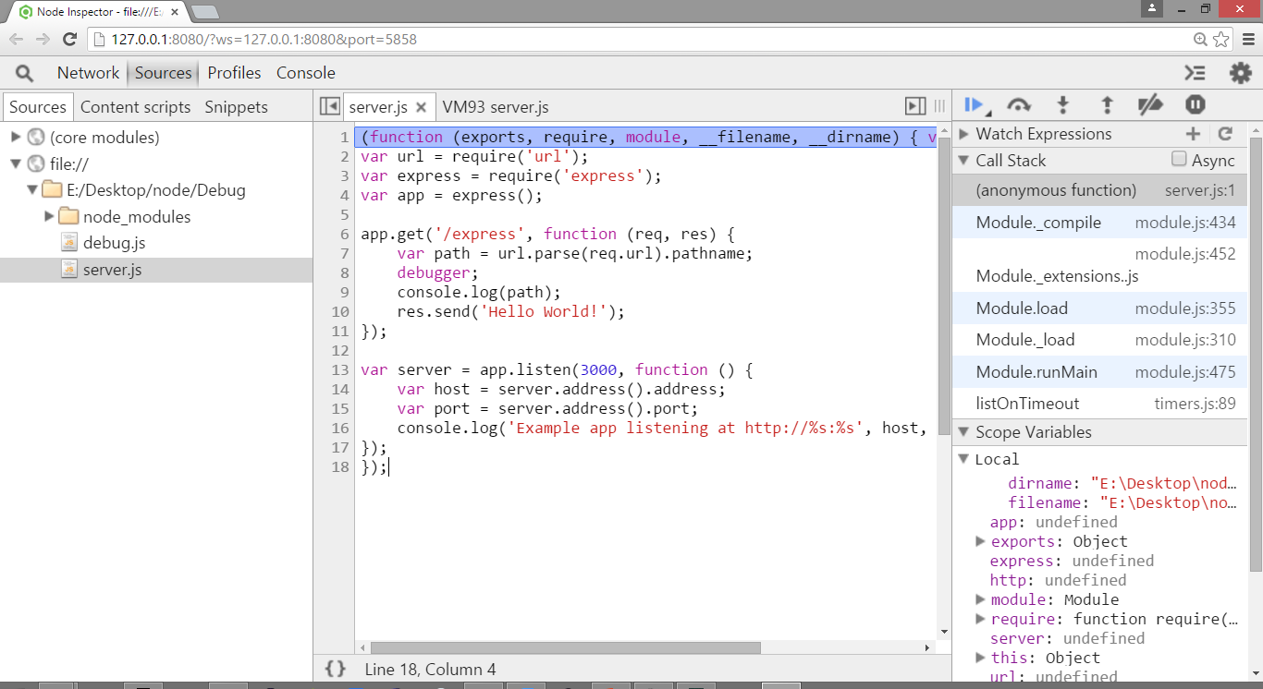
2
Node-inspector
Start Node.js app by node-inspector
Chrome debugger is open automatically with below URL
http://127.0.0.1:8080/?ws=127.0.0.1:8080&port=5858
$ node-debug server.js

Slide 43
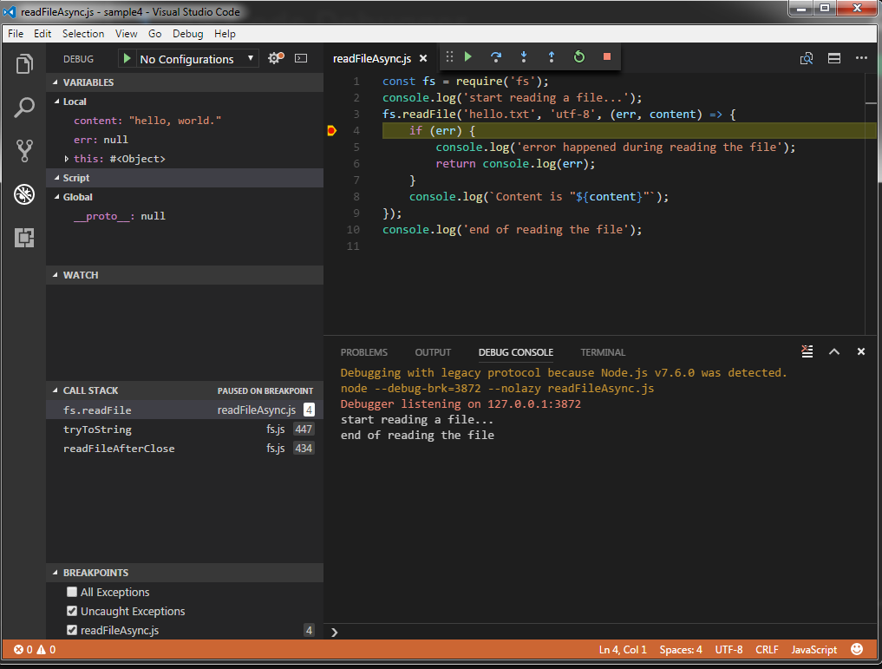
3
VS Code Debugger
Install VS Code
Notes:
demo

Slide 44
8
Exercise

Slide 45
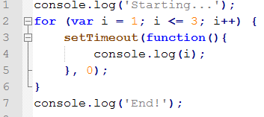
1
Exercise
Write a HTTP Server, print out “Hello Node.js”, and listen 9999 port
Read a file and print out in the console
Move a file to another place
What is the result of below codes?

Slide 46
8
Reference
https://nodejs.org/dist/latest-v4.x/docs/api/
http://nodeschool.io/

